Slide 1
Increasing Access to Health Research
Presented by Aisling Quigley, REACH BC Program Manager
November 8, 2023

Slide 2
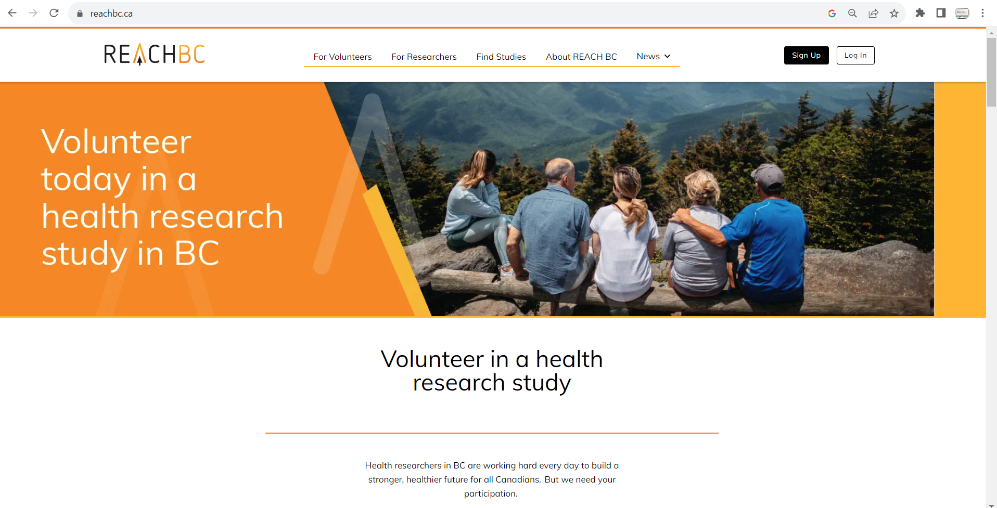
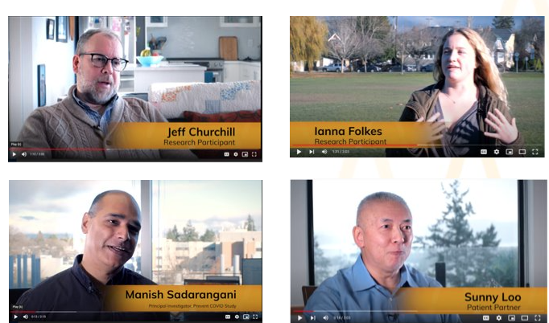
www.REACHBC.ca

Slide 3
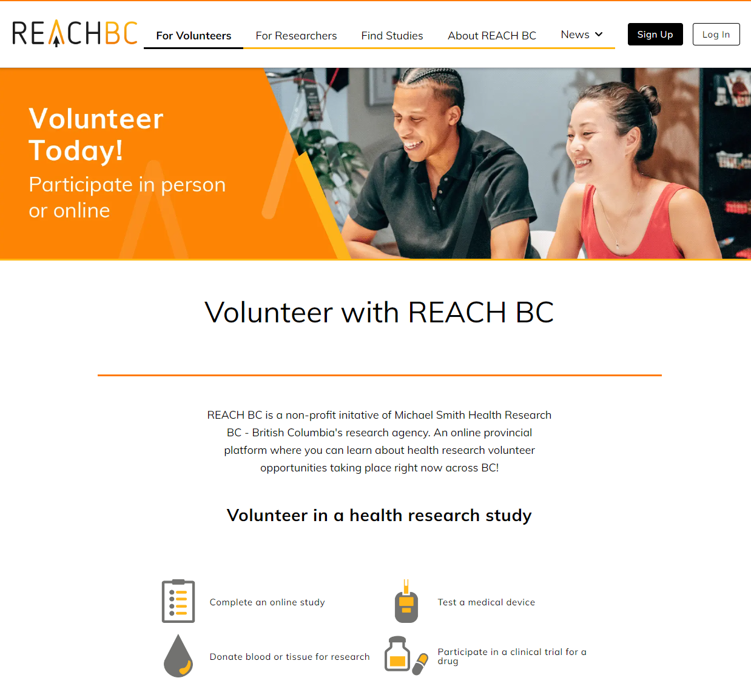
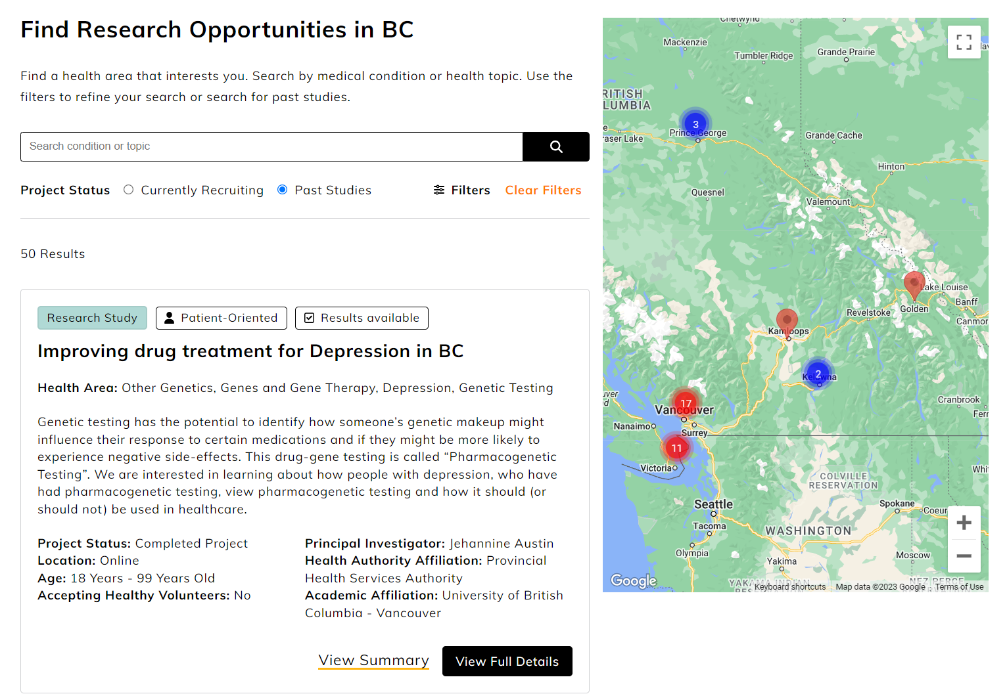
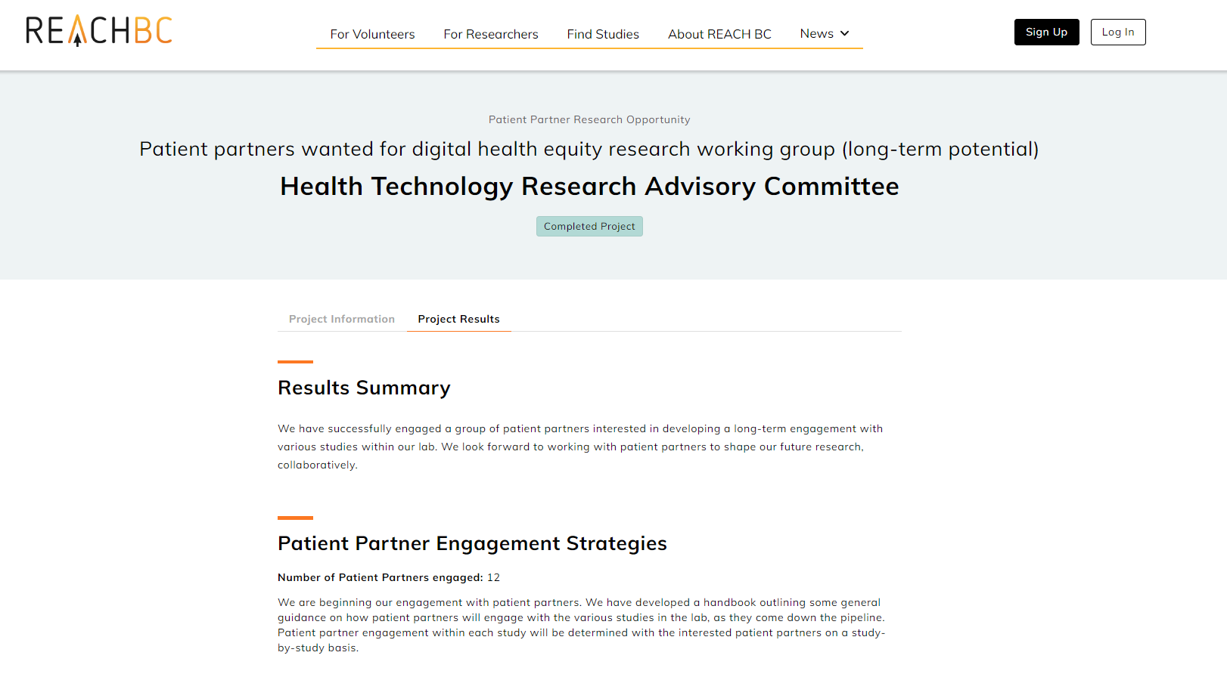
About us

Slide 4
What makes us different?
Sophisticated matching algorithm
Advanced technology
Personal volunteer/researcher dashboards
Full time support service and team
A broad range of health research studies across BC

Slide 5
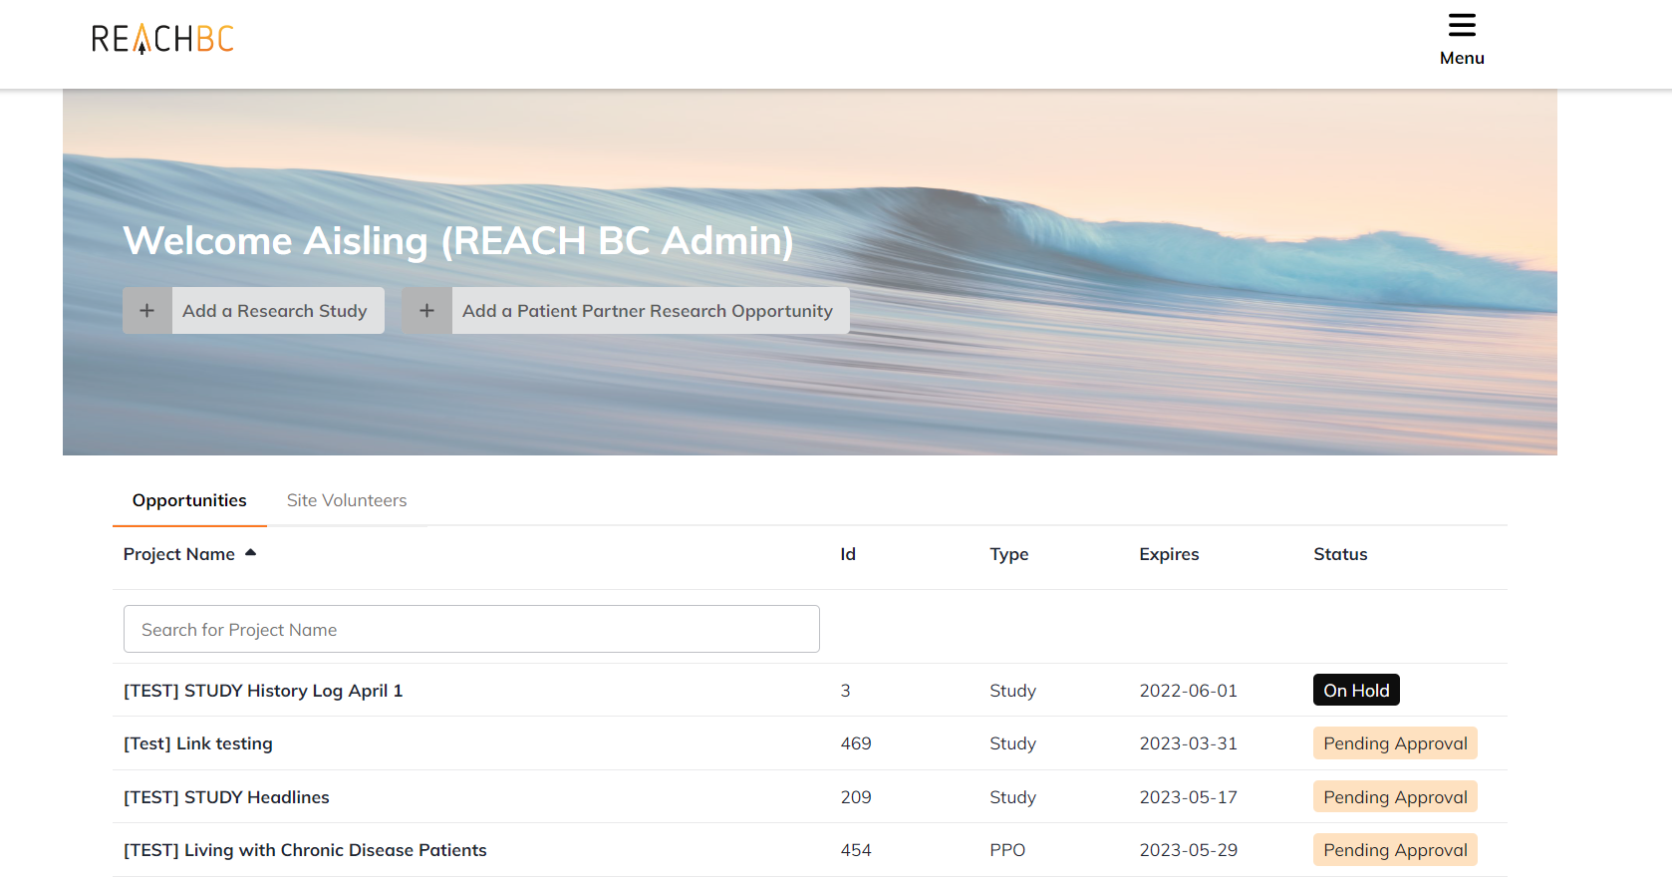
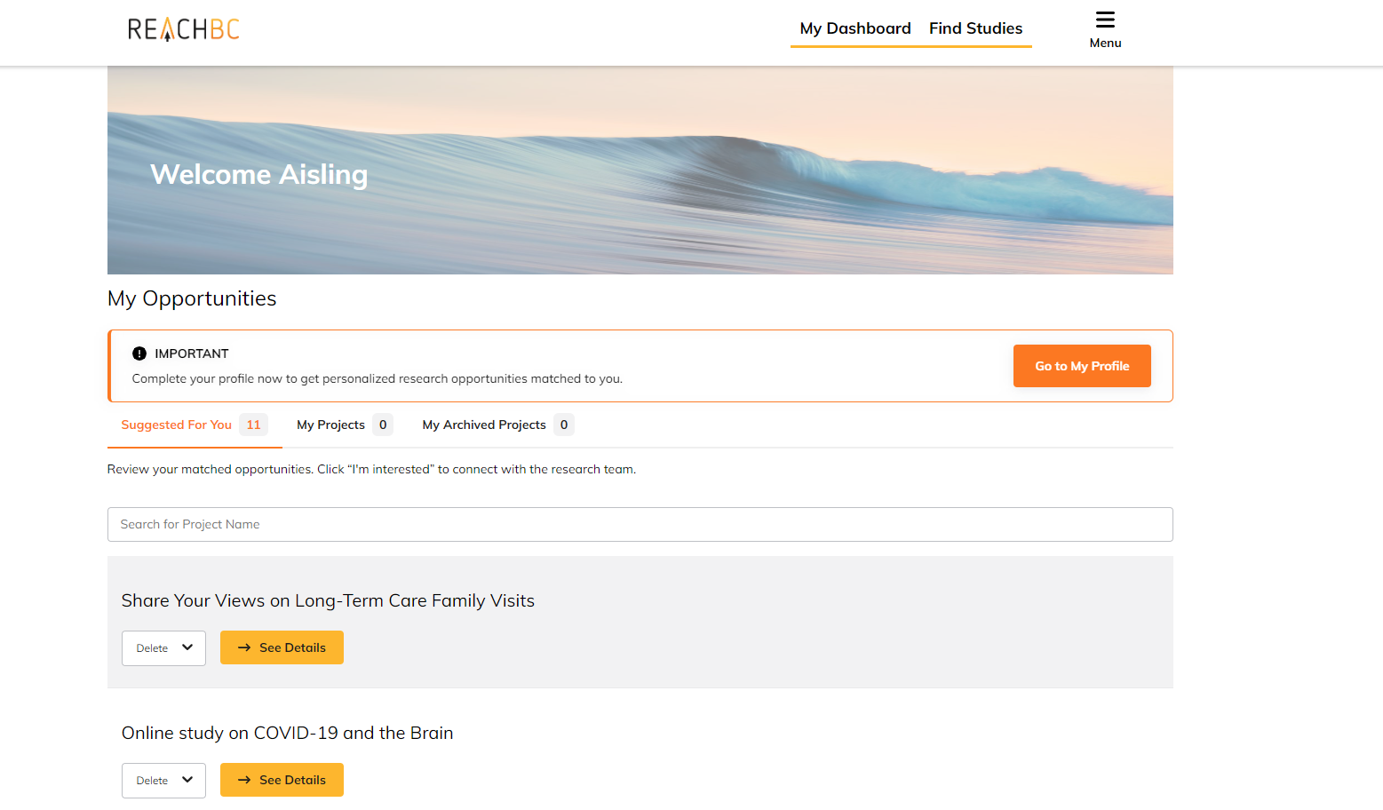
Private dashboard

Slide 6
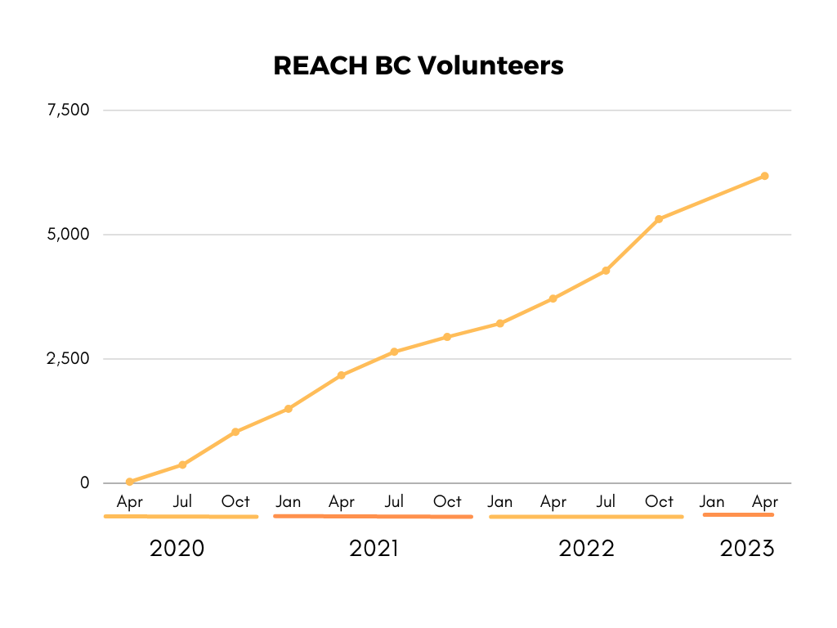
Our Metrics
As of November 6, 2023
>6830
Volunteers registered​
>13,500
"I'm interested" clicks
~688
Projects listed on the REACH BC Directory​
>2,128
Volunteers enrolled
in a study or patient partner opportunity
*excludes direct participation via a link and interested volunteer statuses which have not been updated by researchers.

Slide 7
Year on year growth

Slide 8
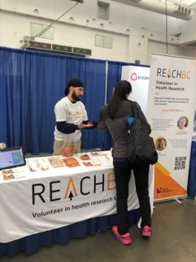
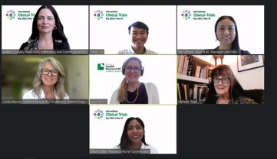
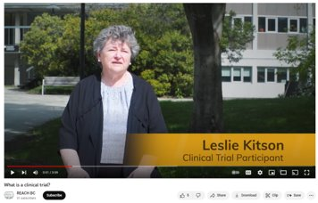
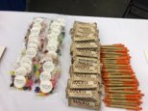
Planned activity
UX User testing
Events
Registration sites
Digital campaign
Education

Slide 9
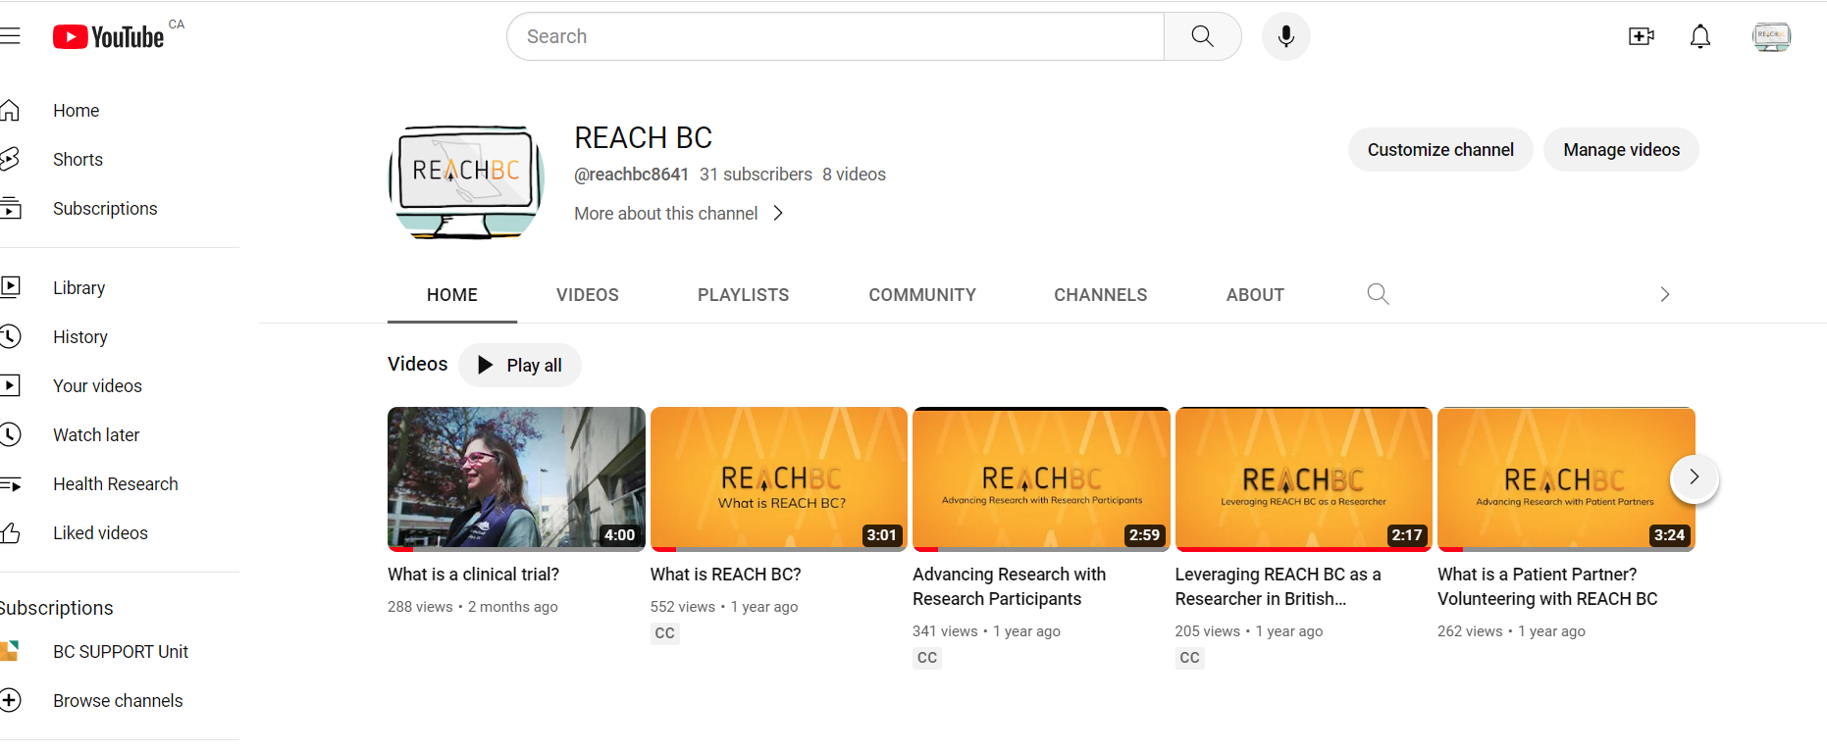
REACH BC YouTube series

Slide 10
Let’s connect
Thank you.
Aisling Quigley, Program Manager
aquigley@healthresearchbc.ca
www.REACHBC.ca

