Slide 1
Simple tools and accessible help ensures Real-Time Virtual Support can wrap care around rural patients
November 9, 2023
with Tom Skinner, Rural Coordination Centre of BC
and Dave Harris, Northern Interior Rural Division of Family Practice

Slide 2
We are grateful to work and play on the unceded lands of the Musqueam, Squamish and Tsleil-Waututh Nations. We also acknowledge the lands of the Lheidli T’enneh where this conference takes place.

Slide 3
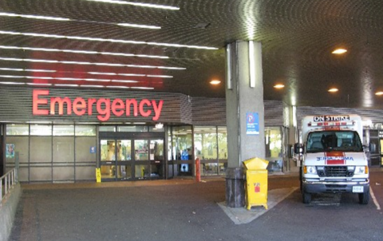
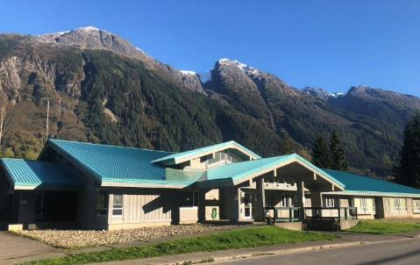
Rural health care looks different
Lack of clinical support increases burden on health care workers
vs
Vancouver General Hospital, Vancouver, BC
Stewart Health Clinic, Stewart, BC
Notes:
Different resources, different medications available
Access to specialists, transport logistics

Slide 4
Traditional Model
Providers in rural and remote communities faced long waits, specialists busy with clinical work at their site.
Specialists at receiving sites often didn’t understand the situation on the ground in rural communities.
Rural providers felt like they had to battle to get patients transferred to a higher level of care
These constant struggles made recruitment and retention of rural providers difficult.
Long wait times
Rural context
Transport challenges
Decreased retention

Slide 5
Since RTVS was launched
Emergency (RUDi) Pediatrics (CHARLiE) Maternity (MaBAL) available 24/7 for rural providers
RTVS Peer Pathways support on-the-ground teams, including nurses at remote nursing stations.
Virtual providers understand the rural situation.
Video-enabled to support provider and patient.

Slide 6
How did we get here?
The COVID-19 pandemic
The need for virtual support was always present, but COVID-19 sped up the urgency to implement it province-wide.
Rural providers needed assurance that they would not be on their own to deal with hospitals full of sick patients.

Slide 7
How did we get here?
Technology needed to be:
Simple to use
Accessible
Uncomplicated
Zoom, iPads & Internet
or
Phone
Notes:
Ideal is a video call from an iPad or Zoom cart over wifi
Many people default to Zoom on their personal phones
Phone backup system as well – direct to on call provider
Personal cell phone as a backup

Slide 8
What has made it work?
Secret sauce:
Focus on people, not technology
Tech team supports rural providers to familiarize themselves with accessing Real-Time Virtual Support
Faculty development for internal team of providers to support growth in providing virtual care
Clinical, Technical, and Cultural

Slide 9
What has made it work?
Changing the Culture
“Why are you calling me?”
“How can I help?”

Slide 10
What has made it work?
Partnerships and Relationships
RTVS was made possible because we worked in partnership with and alongside others, including:
Northern Health
Interior Health
Island Health
Providence Healthcare
First Nations Health Authority
Provincial Health Services Authority
Ministry of Health
UBC Digital Emergency Medicine
UBC CPD
Emergency Care BC
HealthLink BC

Slide 14
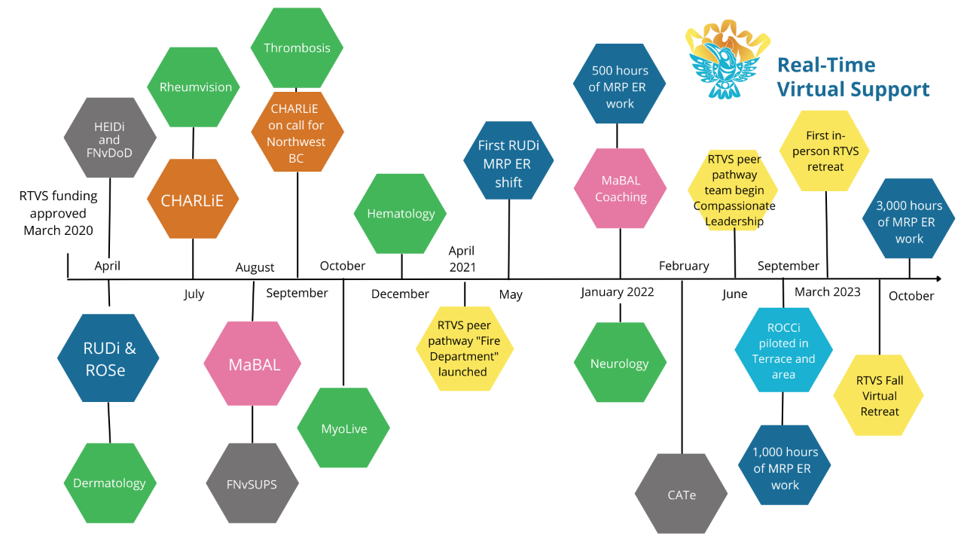

Slide 15
Tech milestones
Over 1,800 providers have signed up for RCCbc Zoom licences
100+ intro to RTVS sessions
Dozens of faculty development sessions with RTVS virtual providers including tips and tricks on:
Transferring a Zoom call from a smartphone to a computer
Connection to traditional telehealth devices
Using secure Zoom for Healthcare platform for sending images

Slide 16
Peer pathway case studies
What impact has RTVS support for rural providers had?
“It’s a game changer. I don’t know that I would be doing rural ED work without it. It makes me sleep at night knowing there is someone on the other end of a phone who can support me in a non-judgmental way. So much of the difficulty of rural ED is the isolation. For the cases I am unsure of, that don’t fit into life-threatening or a simple discharge, the opportunity to speak with a friendly, helpful doctor is really valuable. This service is the only dependable way I have for these conversations.”
—Rural physician

Slide 17
Case study: Older woman with pulmonary fibrosis, hypertension and COVID-19 during Delta wave.
“The physician [on the ground] indicated there was no possible way she could have managed the patient medically without the RUDi and ICU support, in addition to the time and feasibility challenges of attempting to manage a critically-ill patient while spending 60 minutes of time on the telephone with PTN.”
—RUDi physician

Slide 18
Case study 2: Family arrives into ER with baby in cardiac arrest
“Within 10 minutes of arrival to the ER, I was able to connect with one of the pediatricians through CHARLIE. I was able to put him up on the screen. You just had to be there to see the calm that came into the room when his face showed up on the screen. He then graciously and supportively guided us through the resuscitation of the babe until the patient was stable.”
—Rural ER physician

Slide 19
Case study: Woman experiencing complications in labour needs transfer involving two ambulances, a boat and a flight.
“You need a fresh set of eyes that can be there. It’s not a knowledge question, it’s about a second opinion. If you have been working for 24 hours you haven’t always got a clear mind and having that second opinion can stop you from second-guessing yourself.”
—Experienced Rural Midwife
Notes:
Tired rural providers – wanting a colleague for a second opinion. Again, needs to be easy – one click access.

Slide 20
Case study: MaBAL helps with pre-term delivery at a rural site with obstetrical services and CHARLiE stabilizes 28-week baby for transfer.
"I really value the culture of peer support and respect within RTVS and it feels great to be able to bring some calm support to my rural colleagues who do such amazing work under incredibly challenging circumstances.“
—MaBAL physician
Notes:
Being able to pull together a virtual care ‘team’ to wrap around the rural providers and their patients. Two iPads, two teams, two patients.

Slide 21
That could have been a very traumatizing case for me to have right out of Residency and I don't think I would be feeling as comfortable and excited to go back up North if I didn't have RUDi helping me through it.
—New rural locum physician

Slide 22
What’s possible?
Tech barriers to getting most out of RTVS
Lack of equipment
Poor connectivity
How can we support rural communities who lack connectivity, equipment or who face other system barriers when accessing RTVS?

Slide 23
Bridging the digital divide - with NIRD
Patients in rural BC, and especially the North struggle with adequate bandwidth to access video-enabled virtual care.
This does not have to be the case, with low orbit satellite solutions now readily available.

Slide 24
Phase 1: Pilot complete
Setting the scene
A patient with comorbidity and mobility issues living without internet access has been unable to access healthcare easily.
They live in the woods with minimal services and no internet in their log cabin.
When they need to access healthcare, they must be brought via ambulance to the local health care facility. Once their appointment is complete, they have no transportation home. They have no local supports, so they rely on the healthcare facility staff to drive them back home when time permits.
Otherwise, all appointments are by telephone.

Slide 25
Phase 1: Pilot complete
Solution
The primary care team lead nurse brought the following equipment to the patient’s home in order to connect the patient with the local physician for a scheduled video-enabled virtual appointment:
the RV version of StarLink to provide internet
an iPad configured with Zoom
an independent power source
For this pilot, IT support was also present.

Slide 26
Phase 1: Pilot complete
How did it go?
StarLink was set up in the patient’s front yard, connected to the independent power source and was ready quickly.
The iPad was connected to the StarLink WiFi and a Zoom call was placed to the local physician. Video and audio were crystal clear.
The primary care team lead nurse took the iPad into the patient’s home and facilitated the virtual visit by providing physical assessment and clinical feedback to the physician.
The virtual visit ended up being vital…

Slide 27
Phase 1: Pilot complete
Beyond what was planned
The video-enabled appointment resulted in a new diagnosis by the physician.
This new diagnosis required an urgent transfer to a larger center of care for the patient to receive the lifesaving care they needed.
Had this appointment been conducted on the telephone as originally scheduled, this new diagnosis would have been missed and the patient outcome could have been far worse.

Slide 28
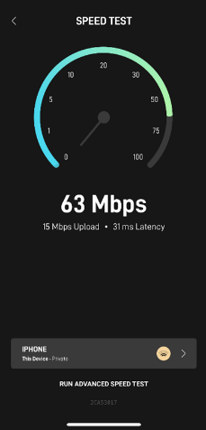
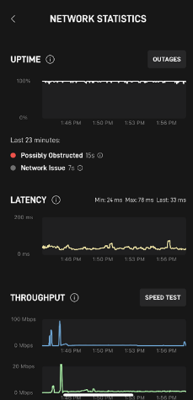
Connection works
This pilot used the portable low-cost form of Low Orbit Satellite technology, and the reliability and bandwidth was more than enough to run a virtual medical clinic.
A video-enabled virtual clinic seeing the patient via Zoom, and having nursing support for physical assessments, can dramatically increase much-needed access to health care for remote patients.

Slide 29
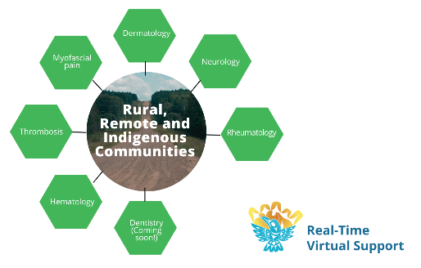
Tie in with RTVS
Six RTVS pathways are available to provide ”Quick Reply” specialist support to rural communities.
Even a patient in the most remote community can see a specialist through a video-enabled Zoom call using low-orbit satellite technology without having to travel outside their community.
Zoom calls can involve the patient, the primary care provider and the specialist or specialized service, enabling effective team-based care.

Slide 30
Questions?
Website: rccbc.ca/rtvs/
Email: virtual@rtvs-bc.ca
Phone: 877-908-8222

